Slide 1

Building Inclusive SEN Provisions Without Segregation
George Habib, M.Ed. | Head of SEN Unit - Beech Hall School Riyadh
Designing, funding and embedding SEN provision that includes rather than isolates

Slide 2
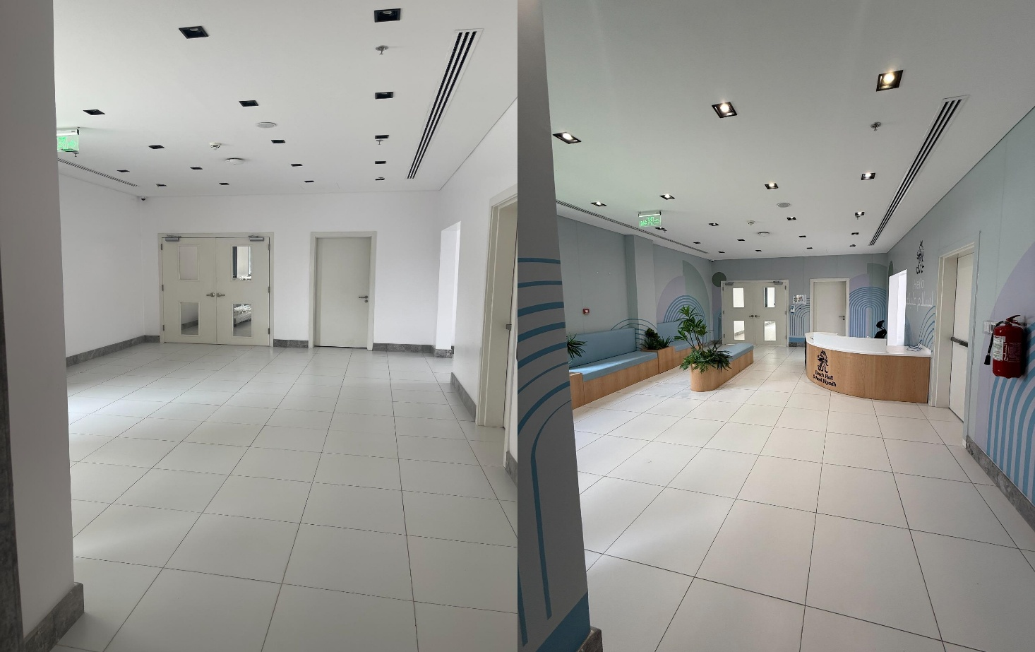
The Starting Point
What "no provision" actually looks like
The school already had inclusion. It worked, and it was full.
• An established inclusion team, operating at maximum caseload
• Children with high-acuity needs arriving faster than capacity could absorb them
• Support stretched thin across too many profiles to stay specialist
• Families with complex needs quietly advised to look elsewhere
• No tier of provision between "mainstream with support" and "not this school"
I was hired to build that missing tier; without pulling those children out of the community.

Slide 3

Three Decisions That Shaped Everything
Made before a single riyal was spent
1. The ratio comes first.
Six children, three adults. Everything else, space, resources, timetable, was designed around that number and defended against it.
2. Needs-led, not label-led.
Children are grouped by what they need to access their day, not by diagnosis or age.
3. Belonging is built into the school calendar.
Not an add-on, not a visit. Every child on the school's list for assemblies, National Day, sports day, trips and performances.

Slide 4
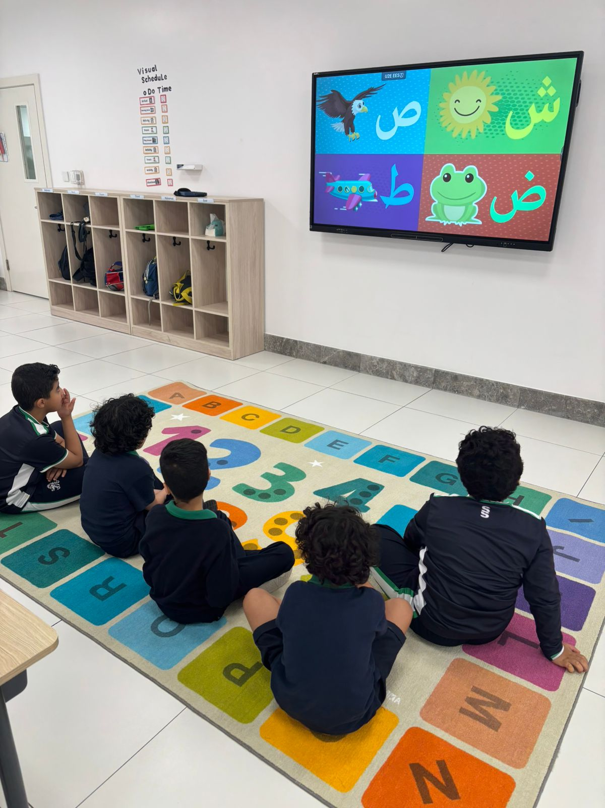
Simple by Design
The classroom had to be safe, compliant, and quiet
Every item in the room passed three tests: is it safe, is it compliant, does it earn its place?
All equipment and materials selected against school safeguarding policy before purchase, not after
Visual simplicity as a teaching decision, uncluttered walls, closed storage, limited colour
Resources rotated in and out by need, not displayed all at once
Nothing clinical.
The room reads as classroom, because that is what it is a busy room competes with the teacher. For high-acuity needs, it wins.

Slide 5
  No Single Curriculum Fits
The IEP is the curriculum
We did not adopt one methodology. We built each child's programme from the approaches their profile actually called for.
• SCERTS : social communication, emotional regulation, transactional support
• TEACCH : structure, visual systems, predictable routines
• ABA-informed strategies : where targeted skill acquisition was the priority
• Early years play-based learning as the constant thread throughout
Each child's IEP names which approaches are being used, for which goals, and why.

Slide 6
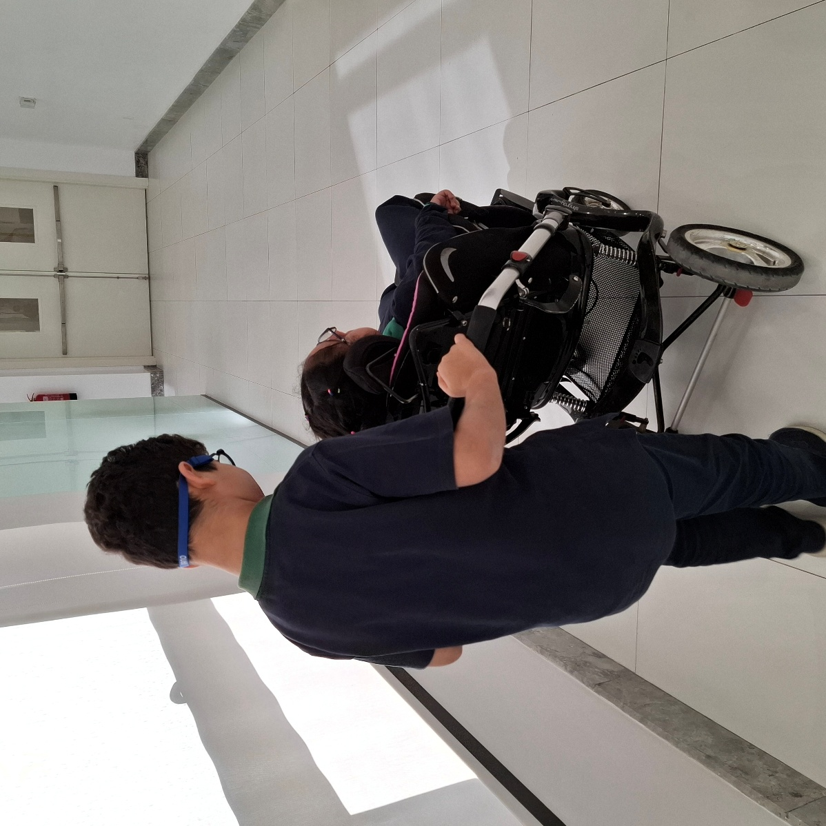
  The Team Around Each Child
Multidisciplinary in practice, not on paper
Class team: SEN specialist · HLTA · care assistant
Plus, for every child:
• SLP and OT pull-out sessions; twice weekly
• A weekly group OT and SLP session delivered inside the classroom, with the class team present
• Therapy targets written into the IEP, not held separately
• The class team carries therapy strategies through the rest of the week
Therapists who only ever work in their own rooms create knowledge the classroom never receives.

Slide 7
  Assess, Plan, Review, Repeat
The cycle that keeps provision honest
• Full informal assessment on entry, covering all developmental areas
• Repeated at the start of each academic year : progress measured against the child, not a norm
• IEP written from the assessment, not from the diagnosis
• Three formal IEP meetings per year with families: share, discuss, align
• Goals reviewed and rewritten as the child moves, not annually by default

Slide 8
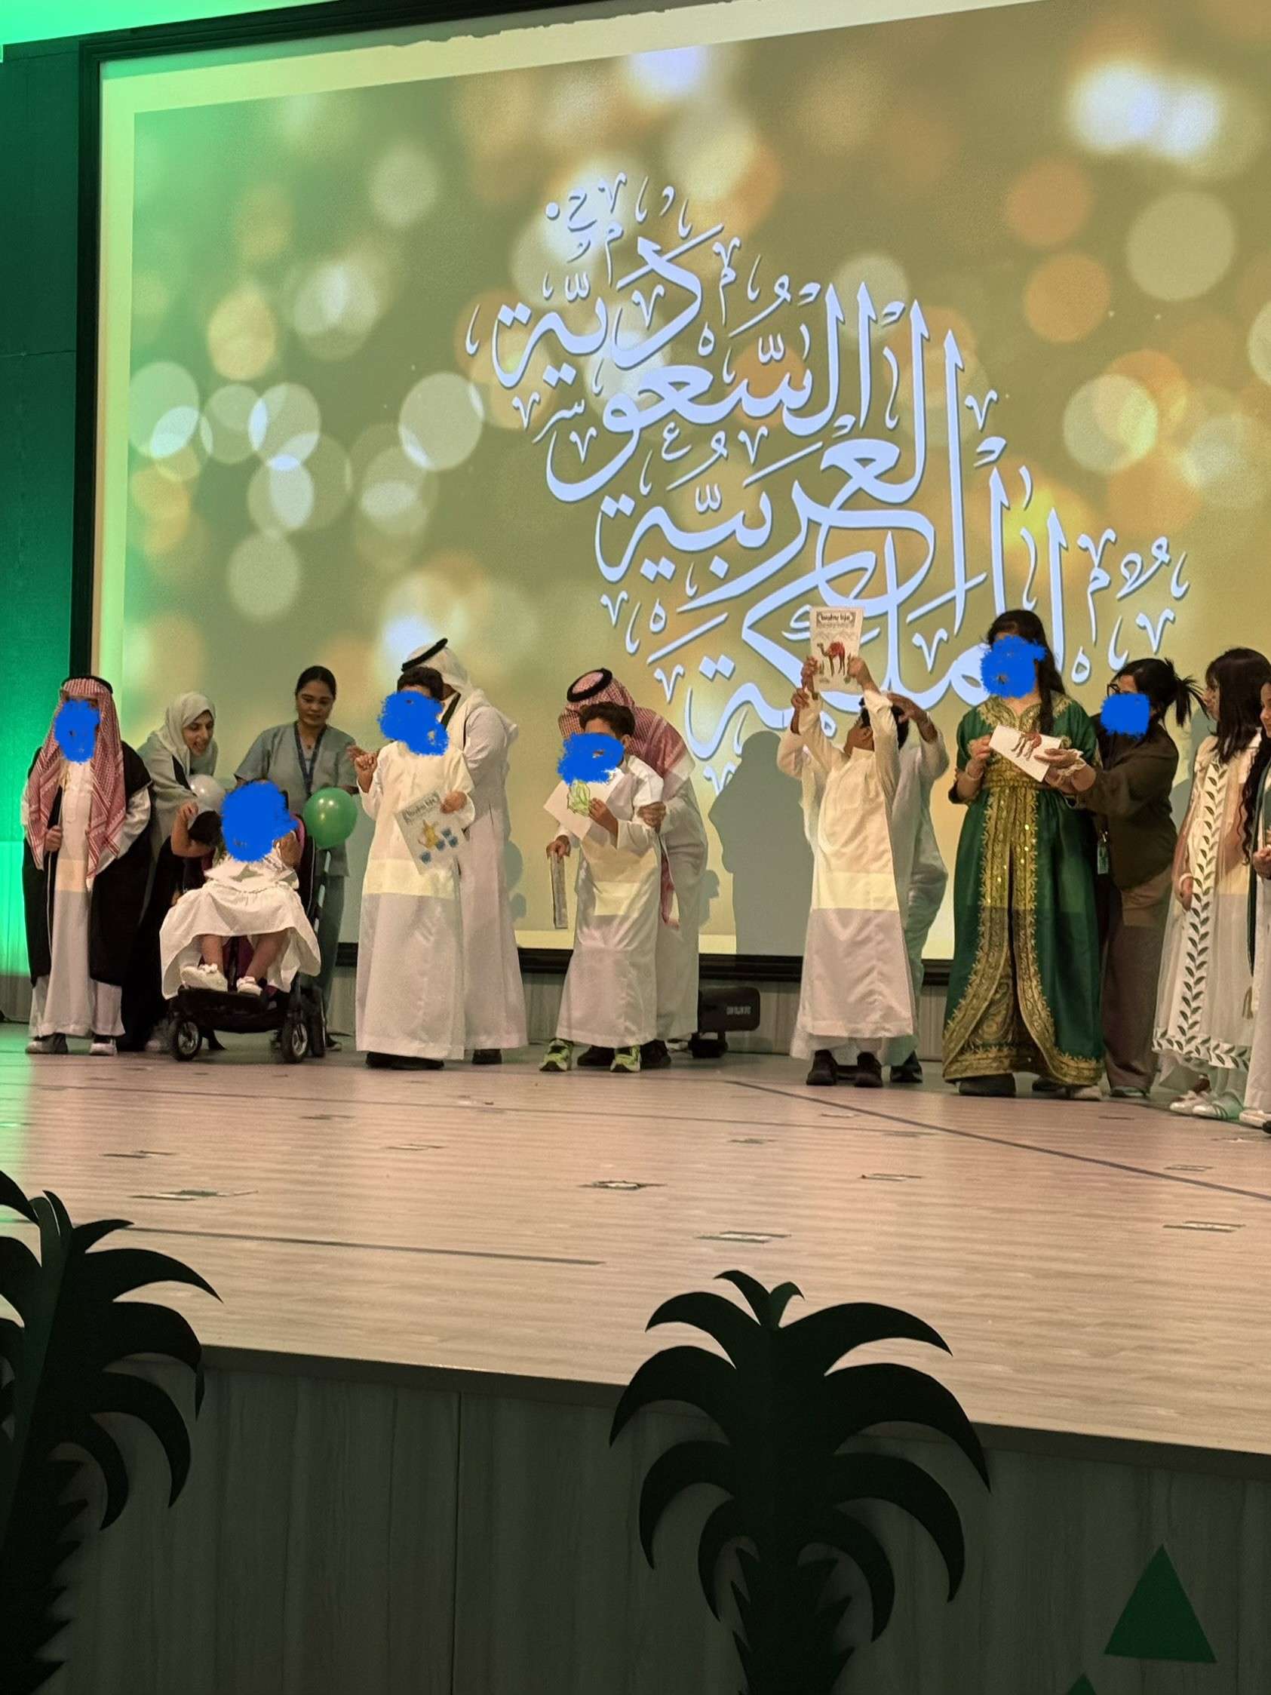
On the Calendar, Not on the Sidelines
Saudi National Day · Founding Day · End-of-Year Show · whole-school celebrations
• Our children are on the participation list from the first planning meeting, not added once the plan is set
• Schedules aligned with school administration in advance, so rehearsals and events fit our timetable rather than clash with it
• Every child has a prepared, rehearsed role
• Rehearsal in the real space, before the day
This required administrative collaboration, not goodwill. Goodwill arrives too late in the planning cycle.

Slide 9
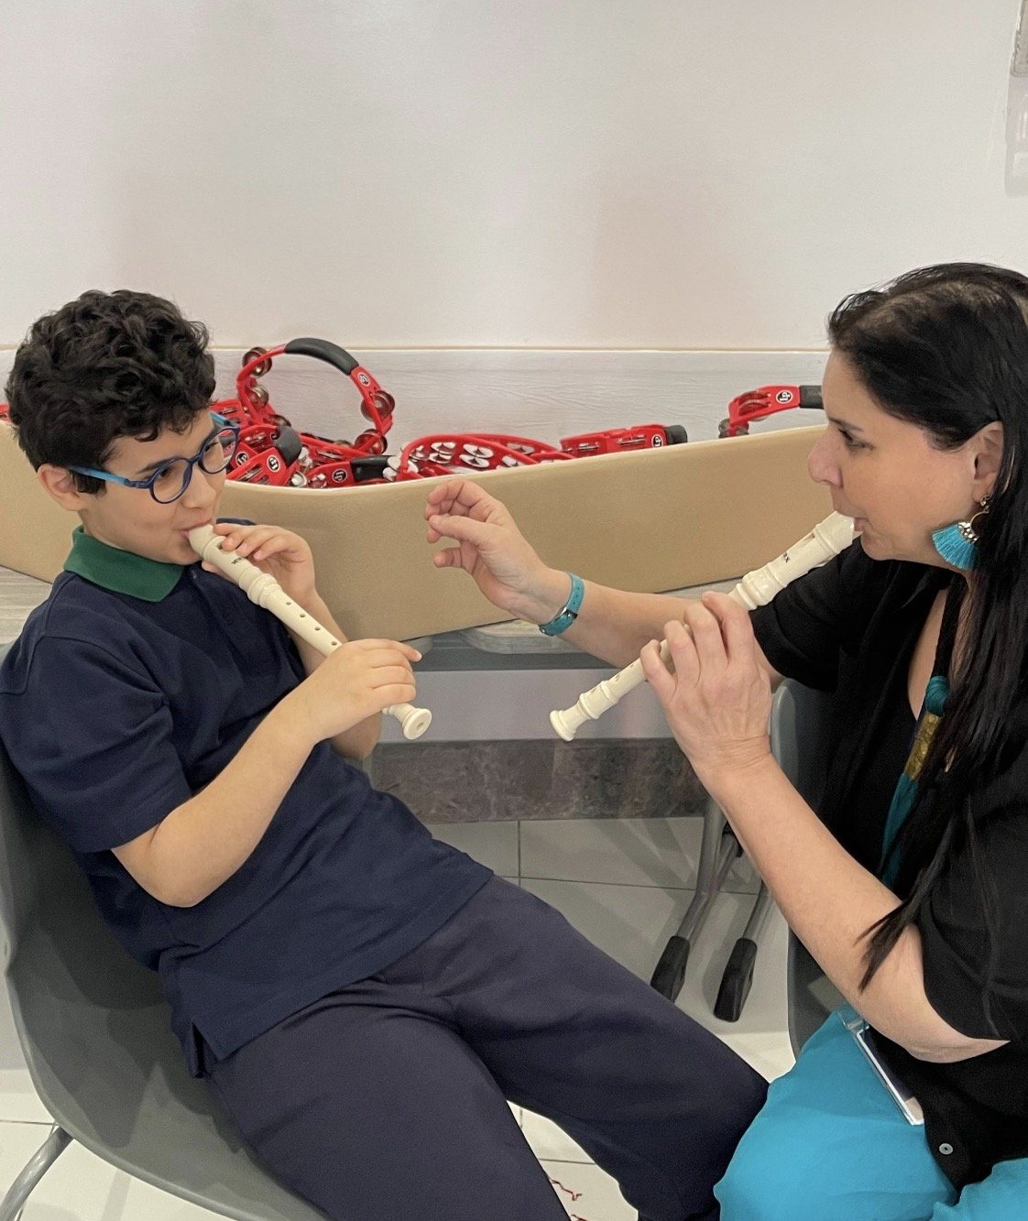
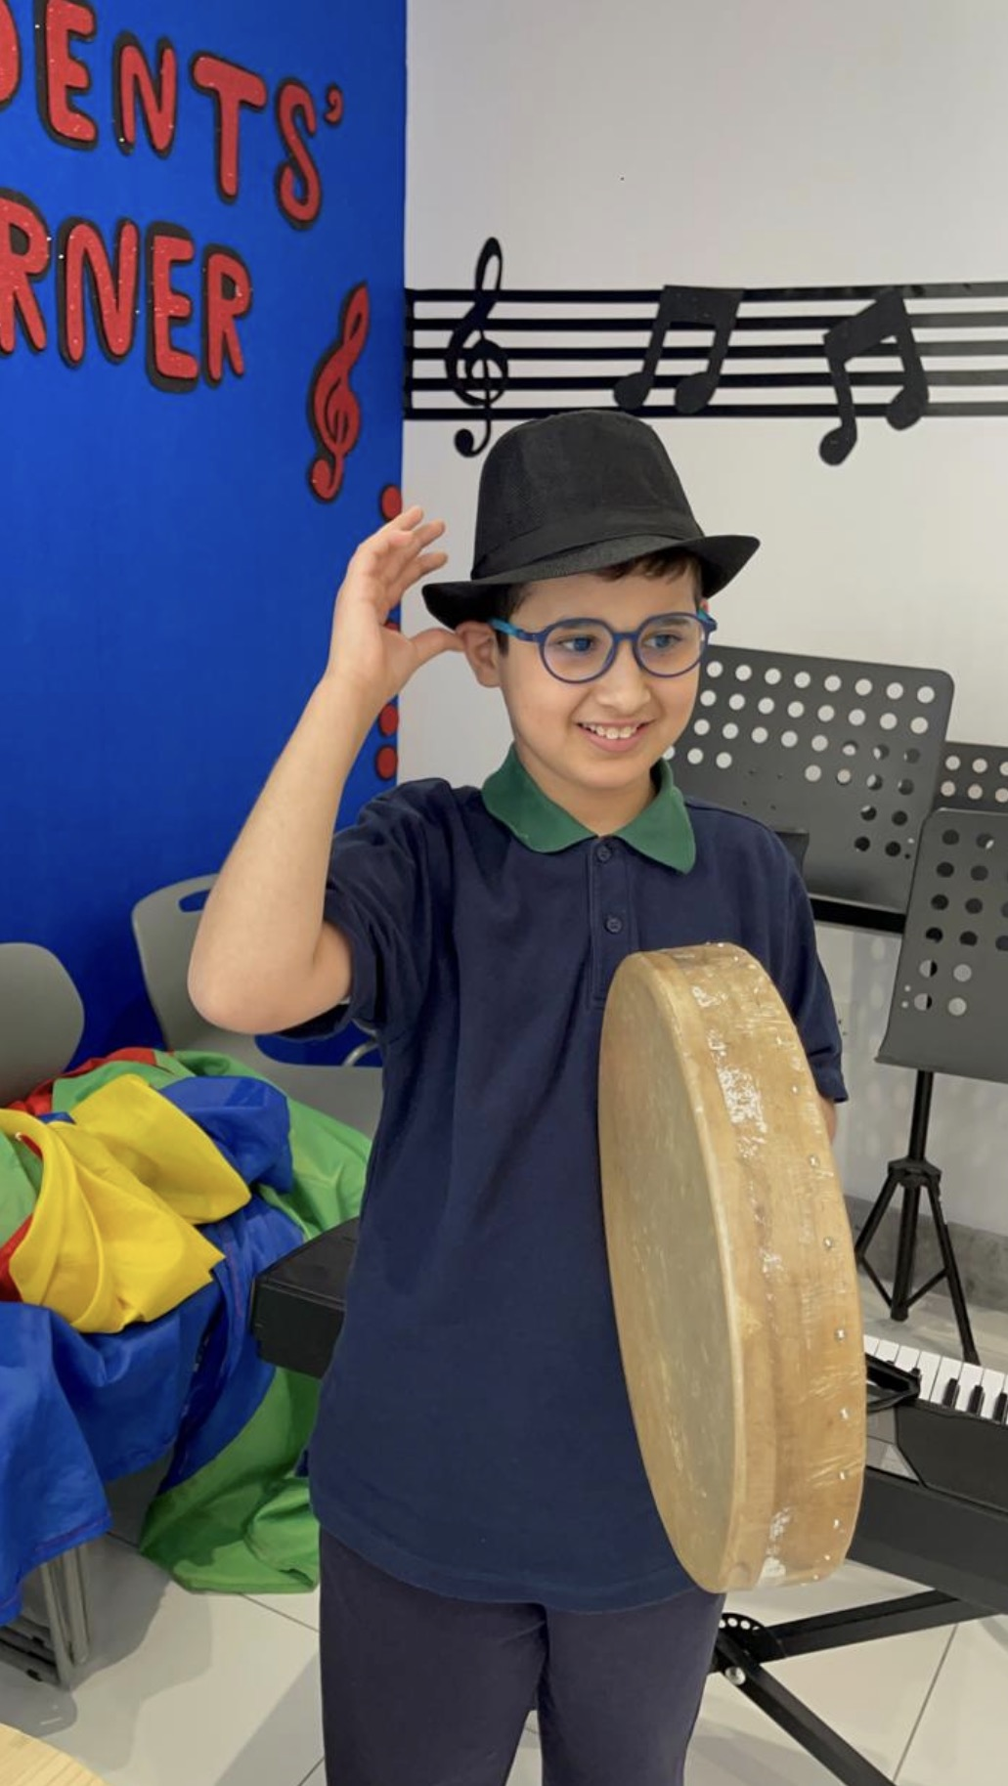
Music, Every Week, All Year
One scheduled commitment, sustained
Every child in the provision attends music in the main school; for the full academic year.
• Accompanied by a member of the Nest team, every session
• Same slot, same room, same peers, predictability is what makes it work
• Not a trial, not a reward, not conditional on behaviour
• A shared, non-verbal subject where our children participate on equal terms
One consistent weekly commitment did more for belonging than any number of one-off visits.

Slide 10
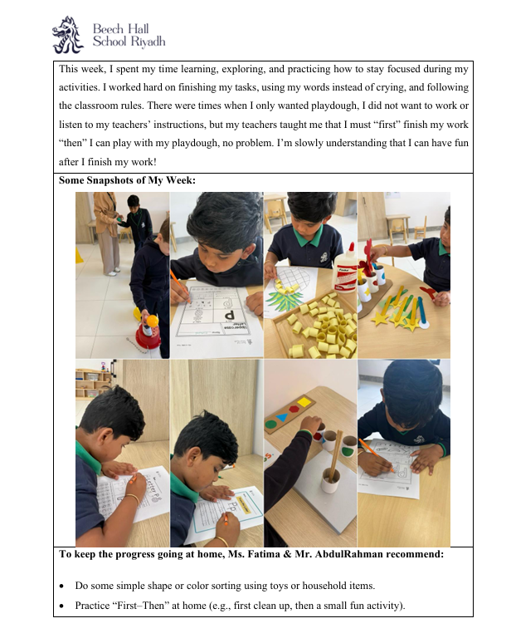
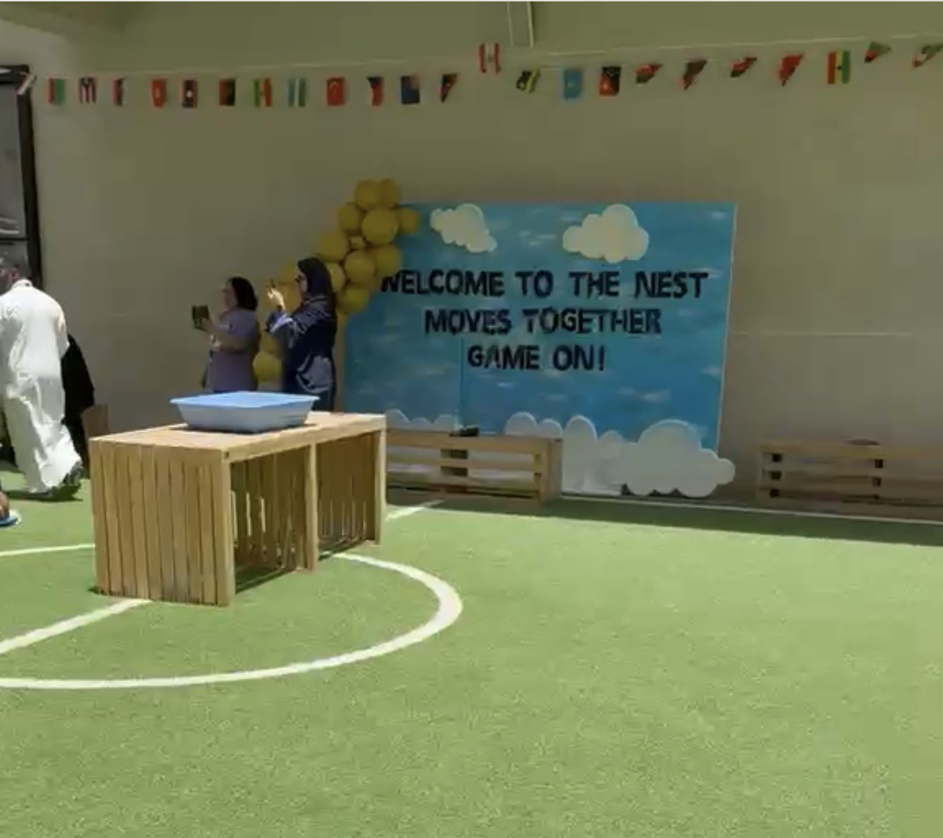
Parents as Partners, Weekly
And part of beneficial events
• A weekly report to every family: activities, goals, behaviour, snapshots of the week, and specific recommendations to continue at home
• A themed calendar for the whole provision, shared with families at the start of the year
• The Nest Moves Together; families join goal-directed activities alongside their children
• Every activity accompanied by a brochure: the goal, the materials, how to run it at home
• When parents see the purpose behind the play, they stop watching and start teaching.

Slide 11
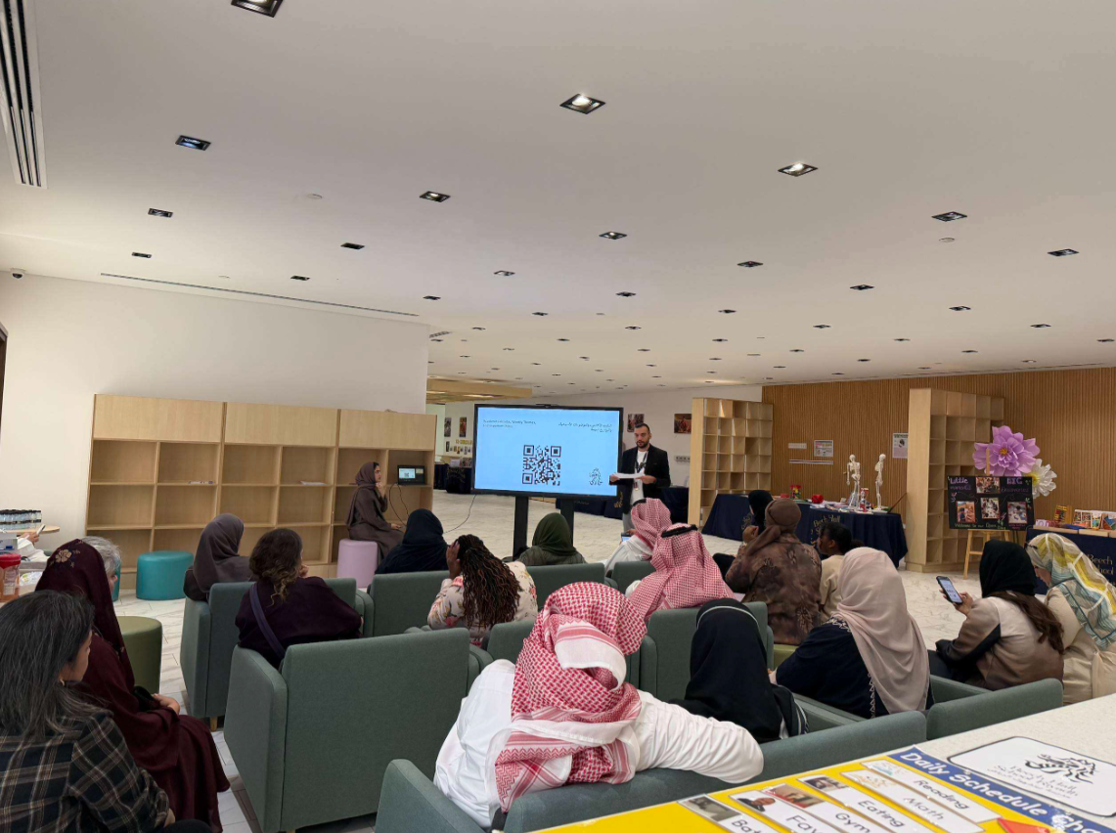
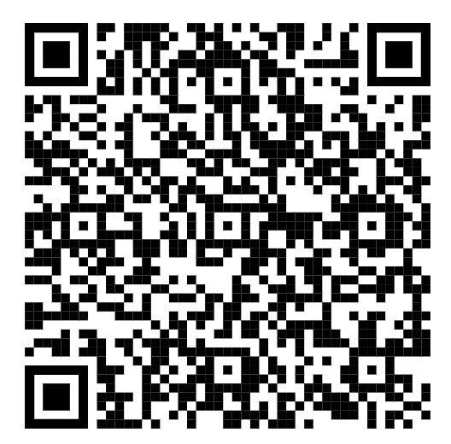
  Three Children to Thirty
Term 3, 2024–2025 to today
• Opened with 3 children in one class
• Today: 30 children across 5 classes, spanning different levels
• Staffed throughout at 6 children to 3 adults
And one child, this academic year, moved fully into a mainstream class, after a full year in the provision, with a transition plan built jointly with the school's inclusion department to protect against regression. Growth is not the measure. What the growth made possible is.

Slide 12

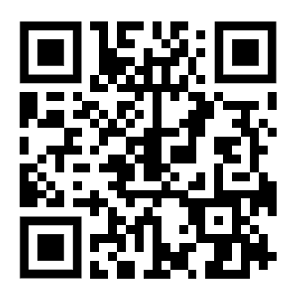
George Habib Head of SEN Unit (The Griffin Nest) at Beech Hall School Riyadh
Founded and leads The Nest, the high-acuity provision at Beech Hall School Riyadh
University Instructor at Saint Joseph University of Beirut
George.habib@beechhallschoolriyadh.com

Slide 13
Thank You for attending this presentation

